Slide 1

Mental Health Promotion: Utilizing Live Your Life Well in the Community
Mental Health America Webinar
May 24, 2012

Slide 2
Bob Decker, Ph.D., NCC, LMHC
President/CEO
Mental Health America of East Central Florida
Daytona Beach, FL

Slide 3
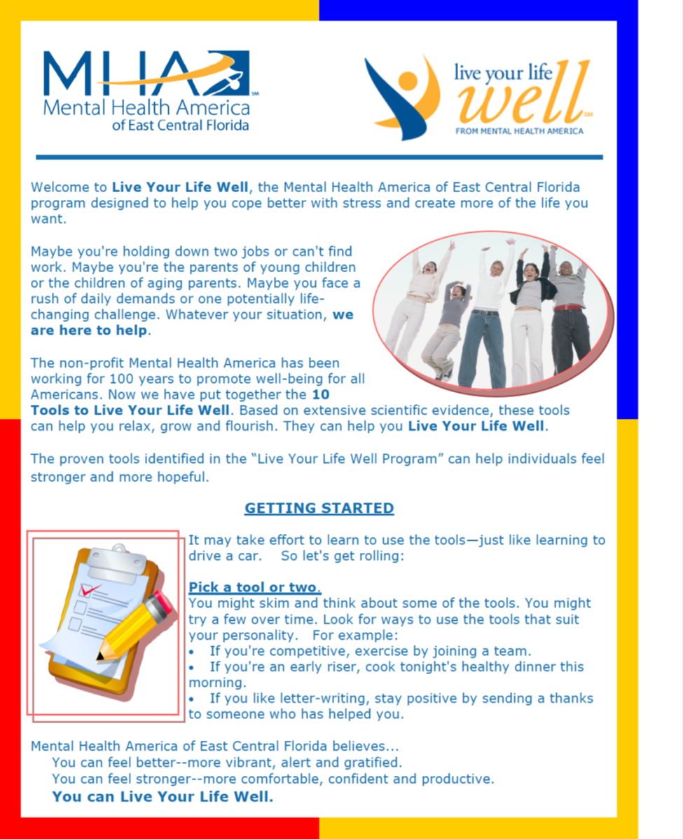

Slide 4
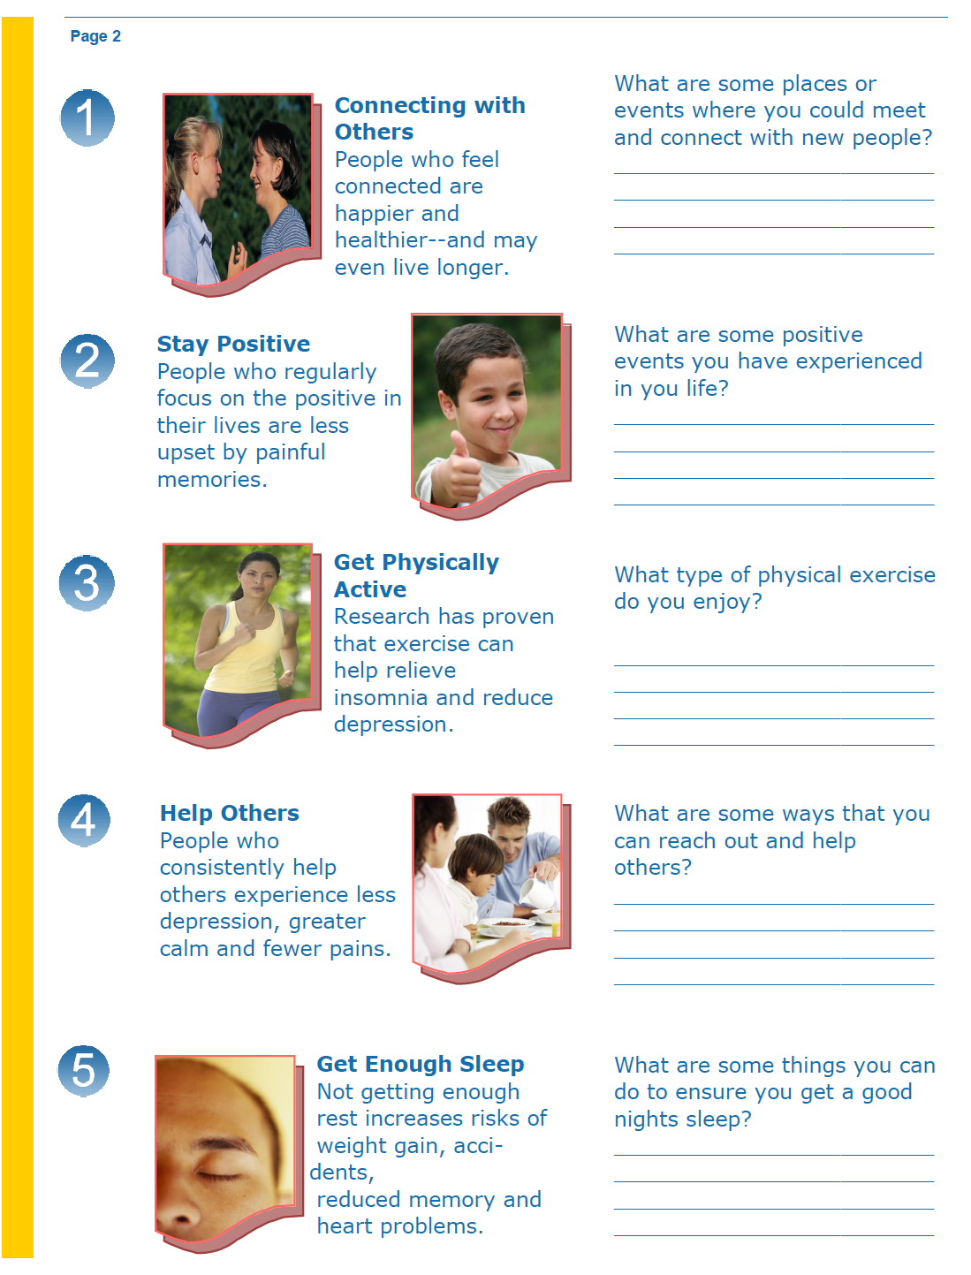

Slide 6
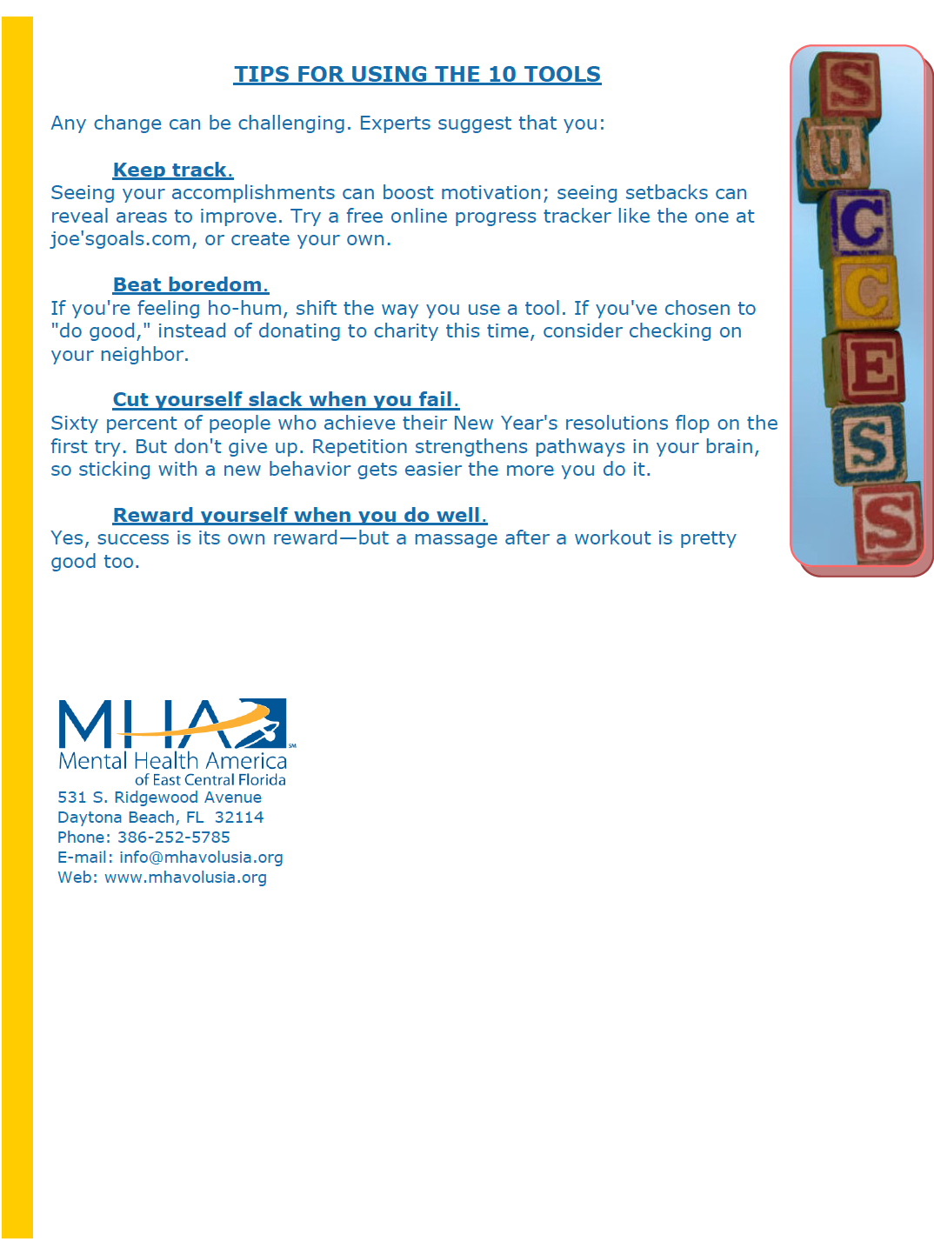

Slide 7

Live Your Life Well is Evidence Based
Hundreds of studies
Thousands of
participants
Over several decades
Backed by universities
and/or government
agencies

Slide 8

Principles of Life Your Life Well
Connect with others
Stay positive
Get physically active
Help others
Get enough sleep
Create joy and satisfaction
Eat well
Take care of your spirit
Deal better with hard times
Get professional help if you need it

Slide 9



Why Mental Health Matters
Emotions, thoughts and attitudes affects:
Energy
Productivity
Overall health
Can lead to serious
mental health
problems such as
depression and anxiety

Slide 10

Stress
Stomach aches
Headaches
Insomnia
Overeating
Back pain
High blood pressure
Irritability
Vulnerability to infection
Other mental and
physical problems

Slide 11
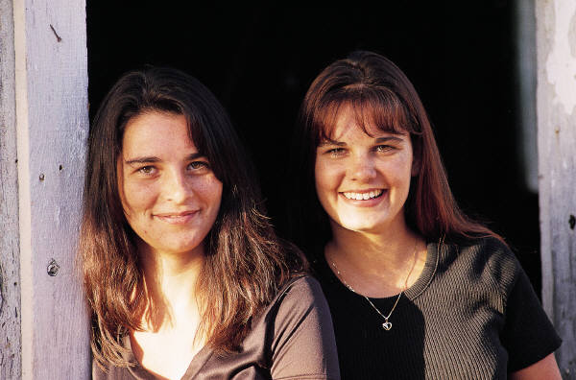


Mental Health Matters
Good mental health can lead to:
Increased productivity
Increased happiness and satisfaction
Better physical and mental health

Slide 12

Take Steps to Promote Your Well-Being
Mental Health America believes that, through taking reasonable and consistent steps:
You can feel better--more vibrant, alert and gratified.
You can feel stronger—
more comfortable,
confident and productive.
F You can Live Your Life Well.

Slide 13

Developing Programs Around Live Your Life Well
Principles are adaptable to many settings and programs
Principles are culturally
competent and applicable
to many diverse populations
Principles may stand alone
or be combined to strengthen
existing programs

Slide 14


Developing Evaluation Components
Determine your needs and desired outcomes
Self-report
Use of the 10 principles in a non-clinical
setting
Self-report surveys – re: Family Developmental Matrix
Self-report goals and objectives (survey)
Other self-reports based on the 10 principles
Clinical tools
Use of the 10 principles in a clinical setting
Short depression screening
Short anxiety screening
Other short clinical tools to measure increase
in functioning or decrease in negative emotions

Slide 15
Integration Into Programs
Mental Health America of East Central Florida

Slide 16

Program Integration
Drop-In Center
Parenting and Family
Stabilization Class
Support Groups
Workplace
Annual Award

Slide 17



Drop-In Centers
MHAECF operates 3 Drop-In Centers
in 2 counties with an average daily
attendance of 42+
The Drop-In Center Program is:
Client driven with Board of Directors
Offers socialization activities
Reduces stigma of mental illness
Provides skill building activities/classes
Outings in community

Slide 18
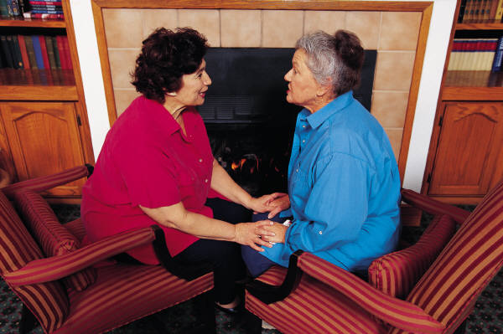


LYLW Integration Into Drop-In Centers
Drop-In Center Survey and Goals
Administered monthly via self-report surveys
One-on-one review of the self-report
Concepts integrated into daily programs
Individual discussions
Activities

Slide 19
Evaluation Components
The Live Your Life Well Survey
10 questions based on the 10 items rated:
Please circle your response using the following scale:
1 = Never = 0 percent of the days for the previous month
2 = Occasionally = Approximately 25 percent of the days for the previous month
3 = Sometimes = Approximately 50 percent of the days for the previous month
4 = Frequently = Approximately 75 percent of the days for the previous month
5 = Always = 100 percent of the days for the previous month

Slide 20
Developing the Questionnaire
Ten clarifying questions based on the 10 items:
EX: Many of our clients live in Assisted Living Facilities that provide meals that may not be the most nutritious. We asked:
“What did you have for your last meal?”
This opened the discussion to educate the client about nutrition.

Slide 21

Goal Setting
Clients identify goals for next month
Clients identify what they will need to help the succeed in achieving their goal
Clients sign the goals indicating their commitment to reaching their goals
Clients identify what they will do to celebrate reaching their goal

Slide 22
Question 1: Social Connectiveness
Social connectiveness has many benefits including increasing happiness, lowers the risk of certain health issues such as high blood pressure, and people with social and community ties were found to be three times less likely to die during a nine year study.
Question 1
I socialized with others during the past month.

Slide 23
Question 1: Social Connectiveness
Outcome
The Drop-In Center clients reported that 52.2% were socially connected at baseline measurement and 63% were socially connected on cumulative for the year indicating a positive change of 10.8% for the reporting period.

Slide 24
Question 1: Social Connectiveness
In response to the question, “What new activity did you participate in during the past month?” some common themes reported were:
Going to church or other social outings
Going out to eat at a restaurant
Playing games
Going places to exercise
Shopping
Talking more with family and friends

Slide 25
Question 2: Staying Positive
Research has found the benefits of staying positive include:
People who were pessimistic had a nearly 20 percent higher risk of dying over a 30-year period than those who were optimistic
People who kept track of their gratitude once a week were more upbeat and had fewer physical complaints than others
People who obsessively repeated negative thoughts and behaviors were able to change their unhealthy patterns—and their brain activity actually changed too.
Question 2
I maintained a positive attitude during the past month.

Slide 26
Question 2: Staying Positive
The Drop-In Center clients reported 50% stayed positive at baseline and 60% on stayed positive on cumulative for the year indicating a positive change of 10% for the reporting period.

Slide 27
Question 3: Physical Exercise
There are many benefits to exercise including preventing heart disease, high blood pressure and other medical conditions. Exercise helps your mood too by decreasing depression, reducing anxiety and increasing the overall sense of well-being. Other benefits include relieving pent-up muscle tension and increasing blood flow to the brain.
During the past month I did some type of physical exercise.

Slide 28
Question 3: Physical Exercise
The Drop-In Center clients reported 39% did some type of exercise at baseline and 58% did some type of exercise on cumulative for the year indicating a positive change of 19% for the reporting period.

Slide 29
Question 3: Physical Exercise
In response to the question, “What is your favorite type of exercise?” the following activities were commonly reported:
Walking, jogging, walking the dog
Bike riding
Push-ups, sit-ups, lifting weights and other exercising activities
Games

Slide 30
Question 4: Helping Others
Doing good things for other people can help to remind us of how lucky we are, make us feel connected to others, help us to feel needed and effective and take our mind off our worries for a while. Helping others can also add a sense of purpose and meaning to our life.
I helped others during the past month.

Slide 31
Question 4: Helping Others
The Drop-In Center clients reported 41.4% helped others at baseline measurement and 58% helped others on cumulative for the year indicating a positive change of 16.6% for the reporting period.

Slide 32
Question 4: Helping Others
In response to the question, “What did you do to help someone during the past month? the following activities were commonly reported:
Helping around the house, cleaning
Attending support groups
Volunteering
Listening

Slide 33
Question 5: Getting Enough Sleep
Getting enough sleep helps to combats some of the fallout of stress, and poor sleep has been linked to significant problems, including: greater risk of depression and anxiety, increased risk of heart disease and cancer, impaired memory, reduced immune system functioning, weight gain and a greater likelihood of accidents.
I got enough sleep during the past month.

Slide 34
Question 5: Getting Enough Sleep
The Drop-In Center clients reported 49.6% did not have difficulty sleeping at baseline and 64% did not have trouble sleeping on cumulative for the year indicating a positive change of 14.4% for the reporting period.

Slide 35
Question 5: Getting Enough Sleep
In response to the question, “What do you do when you cannot get to sleep easily? the following were commonly reported:
Listen to music
Watch television
Meditate
Drink a hot cup of tea
Read

Slide 36
Question 6: Creating Joy and Satisfaction
Experts say good feelings can boost your ability to bounce back from stress, solve problems, think flexibly and even fight disease. Studies show that:
Laughing decreases pain, may help your heart and lungs, promotes muscle relaxation and can reduce anxiety.
Positive emotions can decrease stress hormones and build emotional strength.
Leisure activities offer a distraction from problems, a sense of competence and many other benefits.
I did activities to create joy and satisfaction during the past month.

Slide 37
Question 6: Creating Joy and Satisfaction
The Drop-In Center clients reported 43.6% created joy and satisfaction in their life at baseline and 60% created joy and satisfaction in their life on cumulative for the year indicating a positive change of 16.4% for the reporting period.

Slide 38
Question 6: Creating Joy and Satisfaction
In response to the question, “What activities did you do that brought joy and satisfaction to you during the past month? the following were commonly reported:
Played games
Gardening
Listen to music, watched movies
Went shopping

Slide 39
Question 7: Eating Nutritious Food
Good nutrition can help at times of stress, but that's exactly when lots of us tend to eat less well. Among other benefits, good food can: boost your energy, lower the risk of developing certain diseases, provide fuel to your brain, counteract the impact of stress on your body and affect mood-related body chemicals.
I ate nourishing hot food during the past month.

Slide 40
Question 7: Eating Nutritious Food
The Drop-In Center clients reported 50.4% ate healthy and nutritious meals at baseline and 66% eat healthy and nutritious meals on cumulative for the year indicating a positive change of 15.6% for the reporting period.

Slide 41
Question 7: Eating Nutritious Food
In response to the question, “What did you eat for your last meal?” the following were commonly reported:
Spaghetti
Baked Chicken
Hot dogs
Sandwiches

Slide 42
Question 8: Taking Care of Spirit
Spirituality means many things to many people. Whatever your idea of spirituality, it can offer many possible benefits, including better mood, less anxiety and depression-and even fewer aches and illnesses. Spirituality can provide a sense of purpose and meaning, focus on your own or universal wisdom, way to understand suffering, connection with others and serve as a reminder of the good in the world.
I took care of my spiritual needs during the past month

Slide 43
Question 8: Taking Care of Spirit
The Drop-In Center clients reported 43.2% took care of their spiritual needs at baseline and 60% took care of their spiritual needs on cumulative for the year indicating a positive change of 16.8% for the reporting period.

Slide 44
Question 9: Dealing With Difficult Issues
Having strong coping strategies can make a huge difference when facing stressful situations in our lives. The research shows that people who spent time writing about a difficult event had better health and less depression. People facing stress felt less depressed after problem-solving. People who often focus on the positives in their lives are less upset by difficult memories.
I dealt with difficult issues during the past month.

Slide 45
Question 9: Dealing With Difficult Issues
The Drop-In Center clients reported 31% had some good coping strategies at baseline and 42% had some good coping strategies on cumulative for the year indicating a positive change of 11% for the reporting period.

Slide 46
Question 9: Dealing With Difficult Issues
In response to the question, “What was a difficult issues that you dealt with in the last 30 days?” the following were reported:
Not having money
Child custody and/or divorce
Depression and crying
Medical issues

Slide 47
Question 10: Getting Professional Help
Most people who seek help feel better. For example, more than 80 percent of people treated for depression improve. Treatment for panic disorders has up to a 90 percent success rate. A mental health professional can help you, come up with plans for solving problems, feel stronger in the face of challenges, change behaviors that hold you back, look at ways of thinking that affect how you feel, heal pains from your past, figure out your goals and build self-confidence.
I followed the advice of my doctor or mental health professional during the past month.

Slide 48
Question 10: Getting Professional Help
The Drop-In Center clients reported 53.6% had recently seen a mental health professional at baseline and 70% had seen a mental health professional on cumulative for the year indicating a positive change of 16.4% for the reporting period.

Slide 49
Question 10: Getting Professional Help
In response to the question, “How long has it been since you have seen a mental health professional?” the following was reported:
The average was 15.54 days. The total is inclusive of medical professionals, social workers, and other involved in the client’s recovery process.

Slide 50
Most Significant Changes
Physical Exercise 19%
Spiritual Needs 16.8%
Helped Others 16.6%
Create Joy & Satisfaction 16.4%
Got Professional Help 16.4%

Slide 51


Parenting and Family Stabilization Class
Court-ordered 4-hour intensive class for residents of Florida who have children and are going through divorce
Fee based program
Class content must be approved by the Florida Department of Children and Families
Specific components must be included
Certificate sent to court for verification of attendance

Slide 52

LYLW Integration Into Parenting and Family Stabilization Class
Divorce can be a major stressor for parents and self-care is important in dealing with stress:
LYLW provides tools to:
Reduce stress
Increase coping skills
Evaluation components
are for overall class and
not specific to LYLW

Slide 53

Support Groups
Depression
Bipolar
Survivors of Suicide
LYLW IMPORTANT CONSIDERATION…
(No stigma attached)
Note- the need for support groups will likely continue to grow as an adjunct to treatment as resources dwindle and budget cuts continue affect treatment options.

Slide 54

LYLW Integration Into Support Groups
LYLW Support Group as a stand-alone group
Developed 10 week curriculum
One item per week for 10 weeks-begins again week 11
Open group-clients may begin at any time
Support Group Facilitator Training
Evaluation component
Self-report survey on use of
10 items given each week
Depression survey given weekly

Slide 55

Support Group Adaptability
General public support group
Taking place of depression and bipolar groups
Special populations
Victims of domestic violence

Slide 56
Evaluation Outcomes
LYLW Survey
Depression Scale
Issues
Not all people who started the group completed the 10 weeks
Questionnaires can be cumbersome for weekly meetings and eat up time

Slide 59

Workplace
MHAECF regularly provides training and support for local businesses on such topics as:
Depression
Mental Illness
Suicide prevention
Other topics as requested

Slide 60

LYLW Integration Into the Workplace
Development of
2 hour presentations
Evaluation component
Presentation evaluation

Slide 61
Annual Award
Awards presented at Annual Meeting:
Golden Bell Award
Community Service Award
Volunteer of the Year Award
Media Award
In 2011, MHAECF added the Live Your Life Well Award for a client who has made significant progress in their life using the Live Your Life Well principles.

Slide 62

Live Your Life Well Promotion
Logo on business cards
Logo on outgoing mail
Answering machine message “home of the Live Your Life Well Program”
Brochures provided at all presentations
Brochures provided to community

Slide 63
Through using the 10 principles you can …

Slide 64
Questions?
Bob Decker bobdecker@earthlink.net
Sarah Steverman ssteverman@mentalhealthamerica.net
Live Your Life Well www.liveyourlifewell.org

